Slide 1
Strongly Typed Language Support for Internet-scale Information Spaces Overview + Themes
Don Syme Principal Researcher, F# Community Contributor
In conjunction with many others

Slide 2
Proposition 1 The world is immensely information-rich

Slide 3
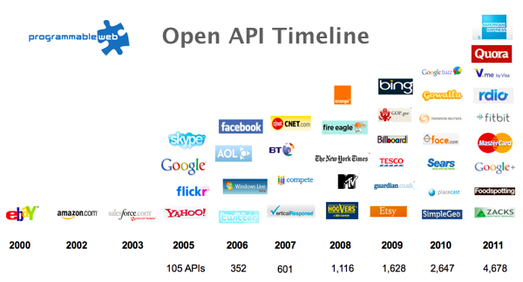
The Information Revolution

Slide 4
Proposition 2 Modern programming is intensely information-rich

Slide 5
Proposition 3 Our languages are information-sparse

Slide 6
Proposition 4 This is a problem (especially for strongly-typed languages)

Slide 7
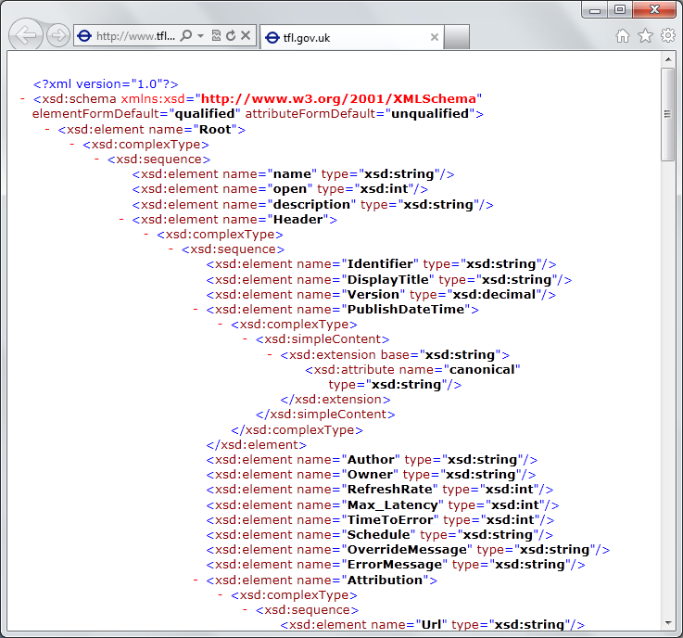
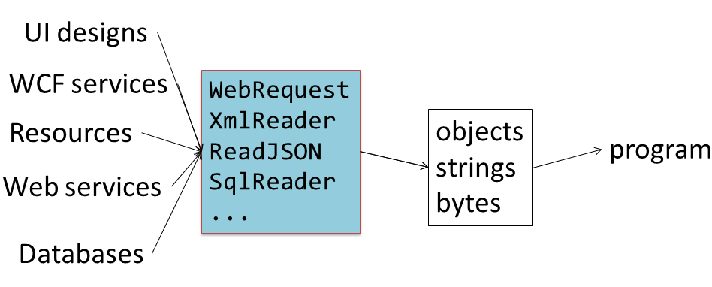
The developer’s perspective
Languages do not integrate information
Non-intuitive
Not simple
Disorganised
Static
High friction

Slide 8
We need to bring information into the language… At internet-scale, strongly tooled, strongly typed

Slide 9
Paradigm Locator
Statically Typed
Dynamically Typed

Slide 10
Paradigm Locator
Statically Typed
Dynamically Typed
A major search is on!
make statically typed langs more dynamic
make dynamically typed langs more static
apply modertated static typing much more broadly

Slide 11
This is done in the context of the open language F#
Lots of good reasons for that, see our tech report
“Strongly Typed Language Support for Internet-Scale Information Spaces”

Slide 12
A bit about F#....

Slide 13
A strongly typed, data-immersive functional-first language for…. simple code to solve complex problems

Slide 14
F# is free, open source, cross platform, independent fsharp.org

Slide 15
F# for Android http://fsharp.org/use/android

Slide 16
F# for iOS http://fsharp.org/use/ios

Slide 17
F# has changed…
F# runs on many platforms
“F# is for Windows”

Slide 18
F# has changed…
F# has many contributors
“Microsoft
makes F#”

Slide 19
Back to the main topic…

Slide 20
We need to bring information into the language… At internet-scale, strongly tooled, strongly typed

Slide 21
Demo: Integrate all of freebase.com “as if it were a library” 40M entities, 1Billion facts, 24,000 types, 65,000 properties

Slide 22
Demo: F# to WorldBank

Slide 23
A Type Provider is…. “Just like a library” “A design-time component that computes a space of types and methods on-demand…” “An adaptor between data/services and the .NET type system…” “On-demand, scalable compile-time provision of type/module definitions…”

Slide 24
Theme #1 On-Demand Type Environment = Internet Scalable

Slide 25
On-Demand Type Provision
let data = Freebase.GetDataContext()
1. Compiler/IDE requests metadata for symbol GetDataContext
Provider reports return type of FreebaseDataContext
data.
2. Compiler/IDE requests contents of type FreebaseDataContext
Provider asks Freebase metadata service for top-level domains
Provider reports top-level domains of Freebase as properties of the type
data.Society
3. Compiler/IDE requests metadata for symbol Society
...

Slide 26
Theme #2 Many Data Sources, One Mechanism

Slide 27
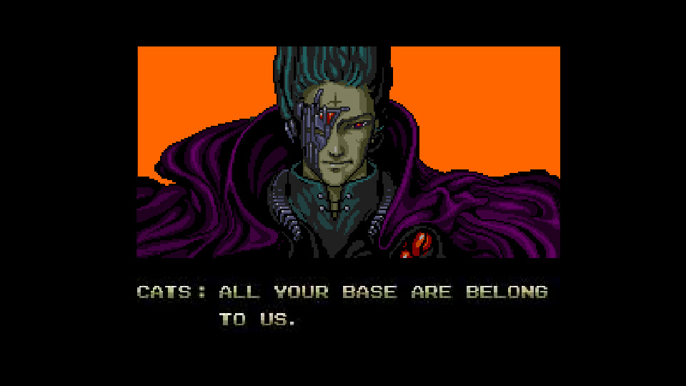
All your types are belong to us….
Segoe UI Light
types

Slide 28
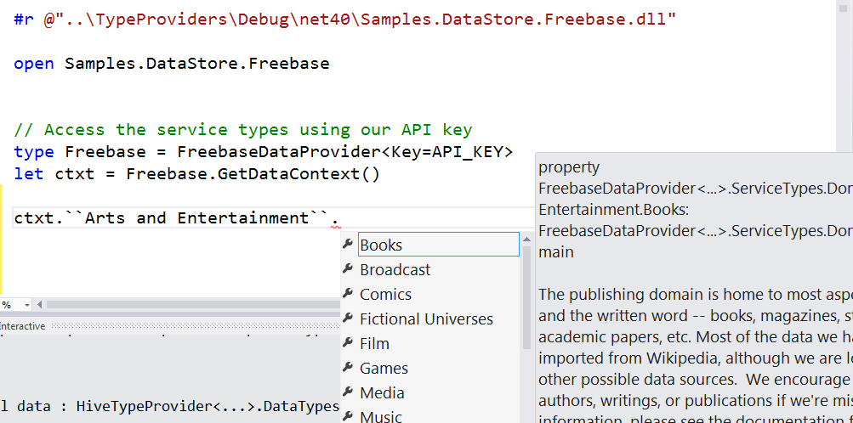
Entity Graphs (e.g. Freebase)

Slide 29
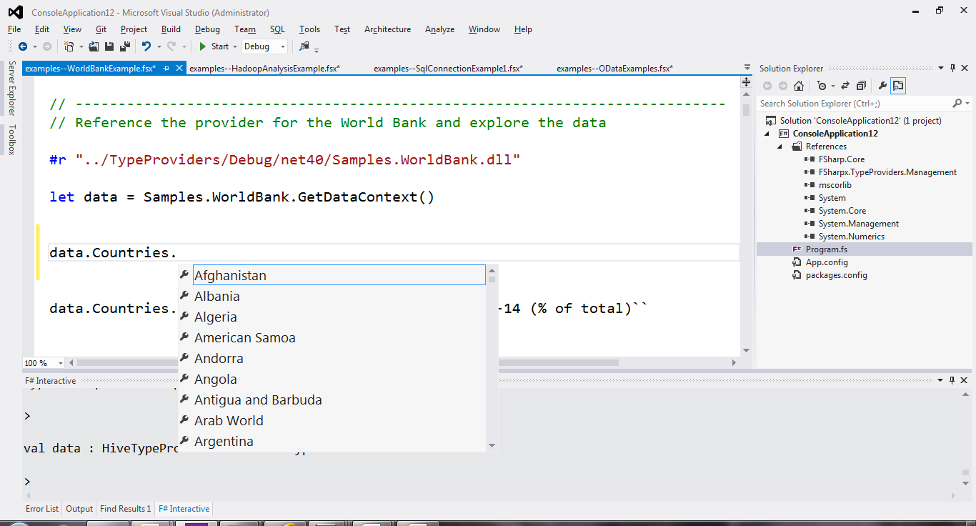
Web Data Sources (e.g. WorldBank)

Slide 30
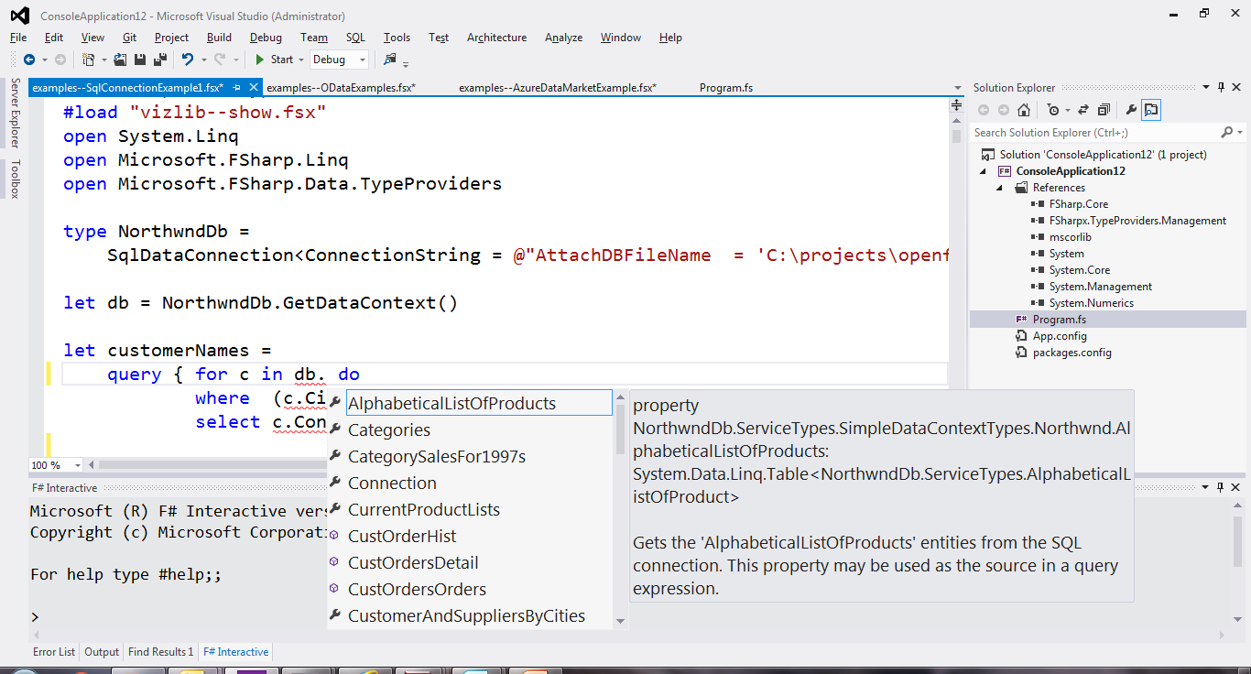
SQL

Slide 31
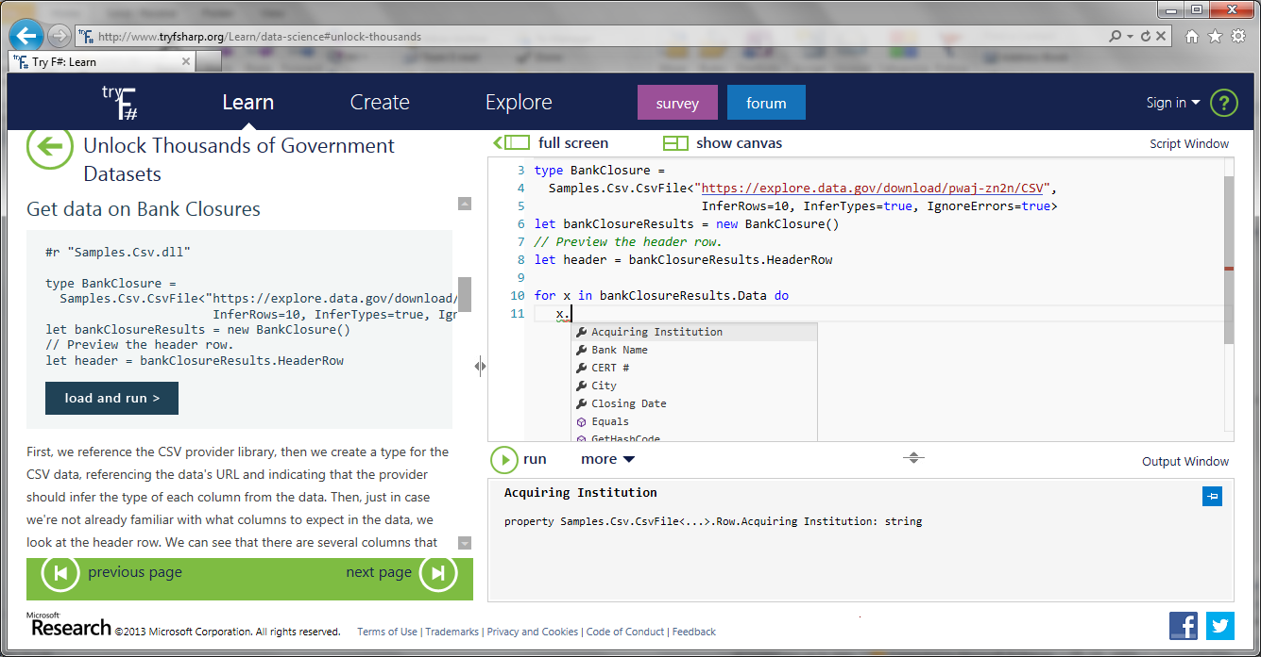
Types from Data (e.g. CSV)

Slide 32
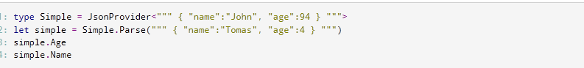
Types from Data (e.g. JSON)

Slide 33
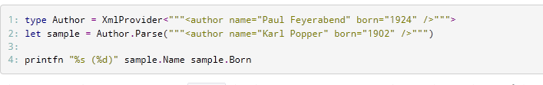
Types from Data (e.g. XML)

Slide 34
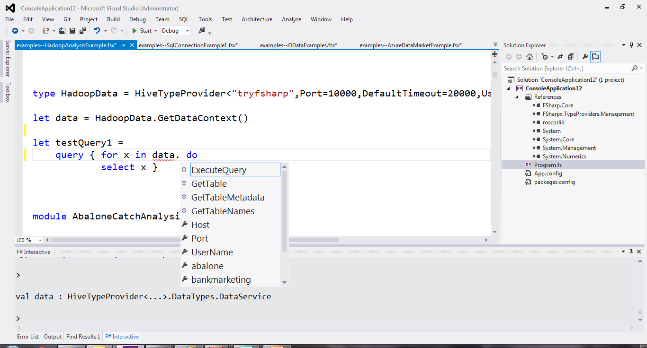
Hadoop/Hive

Slide 35
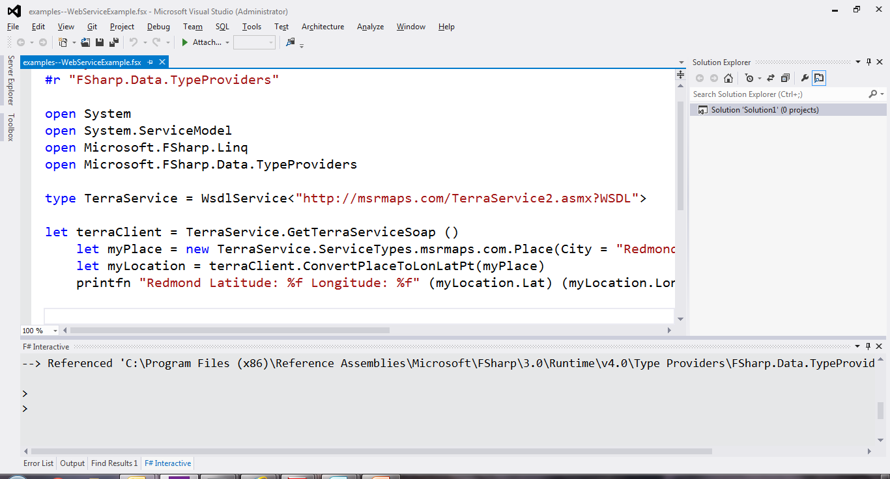
Service Protocols (e.g. WSDL)

Slide 36
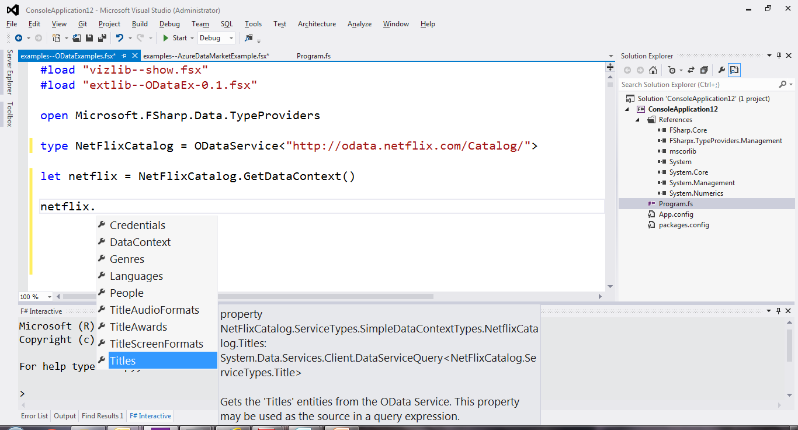
Service Protocols (e.g. Odata)

Slide 37
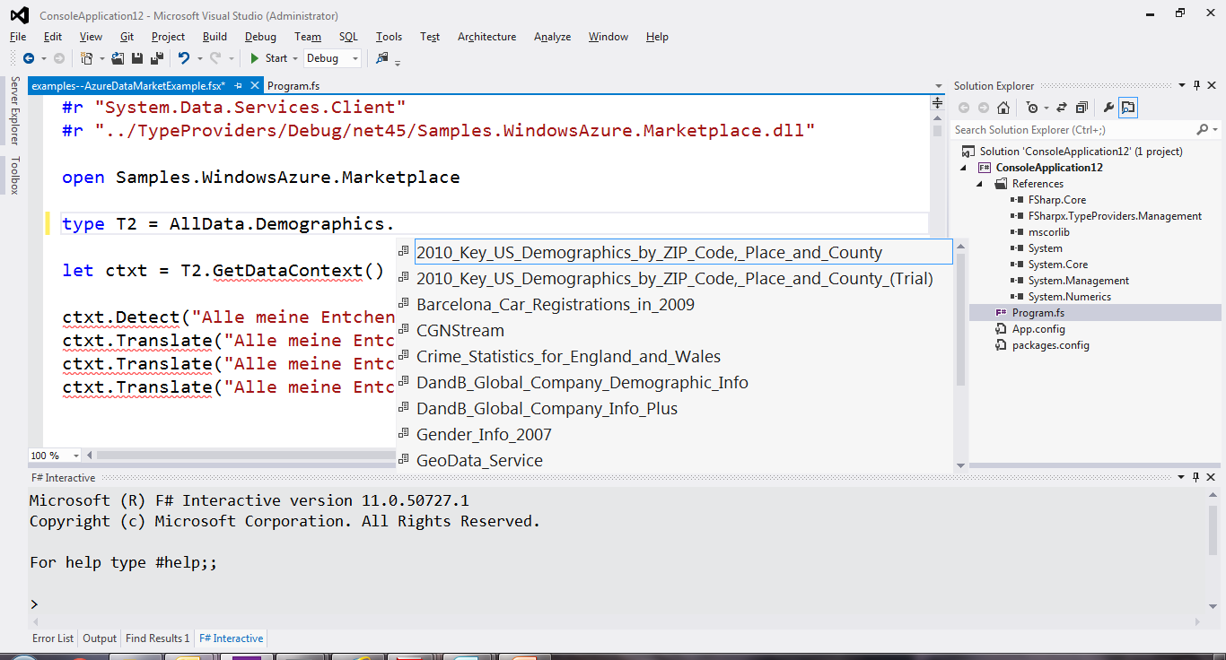
Data Markets (e.g. Azure Data Market)

Slide 38
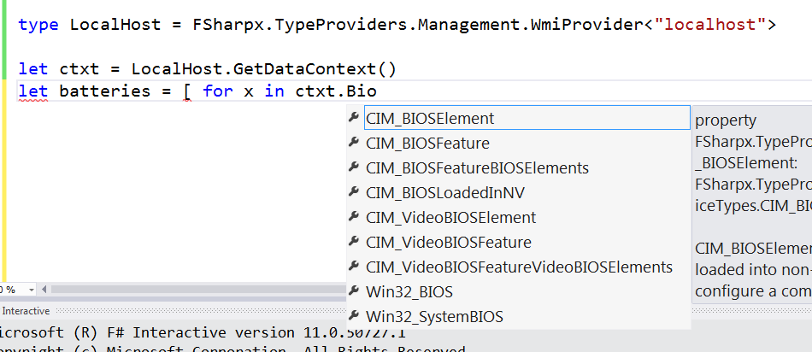
Systems Information (e.g. WMI)

Slide 39
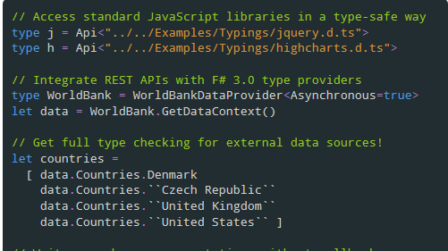
JavaScript/TypeScript

Slide 40
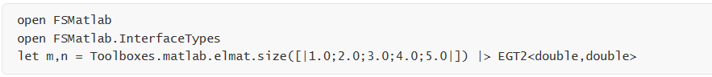
Matlab

Slide 41
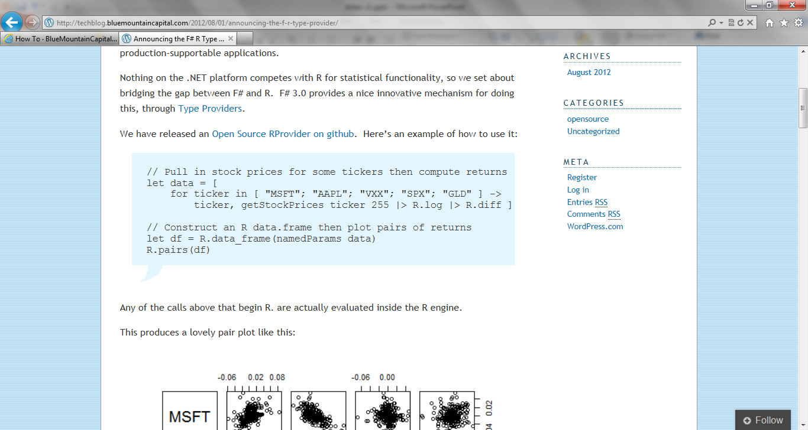
R

Slide 42
Note: Language still contains no data Open architecture You can write your own type provider

Slide 43
github.com/fsharp/FSharp.Data (a library of common type providers)

Slide 44
Theme #3 Data and Types at Multiple Scales

Slide 45
Data at Multiple Scales
From Everything to Individuals
Data Scripters need to work with different granularities of schematization
data.AllEntites
data.Automotive.``Automobile Models``
data.Automotive.``Automobile Models``.Individuals.``Porsche 911``
…Only a language that supports massively scalable metadata can operate at all these levels
Every stable entity can get a unique type

Slide 46
Theme #4 Programming Type Systems v. Information Space Metadata Synergy or Conflict? Examples: Types, Schema, Constraints, Units of Measure, Security Information, Documentation, Definition Locations, Help , Provenance, Privacy, Ratings, Rankings, Search…

Slide 47
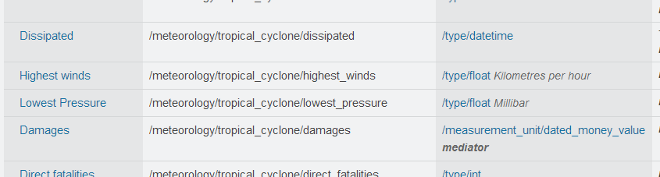
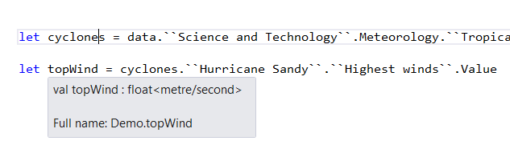
Providing Units of Measure
If the metadata contains units…
via F#’s Units of Measure
…then these can be projected into the programming language.

Slide 48
Theme #5 Type Systems Encounter Reality

Slide 49
This is different…
“The idea of integrating internet-scale information services directly into the program's variable and type space is probably the most innovative programming language idea I’ve heard of in a decade” (Jim Cordy, Queens U)
Perhaps, perhaps not…
But if something so simple is perceived as so different, we need think why
(What follows is somewhat whimsical)

Slide 50
This is different…
We like to see PL systems as logical systems
Traditional logical systems exclude interaction with reality
This is a powerful and simplifying assumption
It is also fundamentally wrong for modern applied programming languages

Slide 51


Γ $⊢ e$ : τ
Lots of work here
Lots of work here
The exclusion of reality!
The neglected child
Γ₀ = 0

Slide 52
Meditations on Γ₀
Γ₀ is the ever-growing ocean of digital reality around us
Γ₀ is big. Really big.
Γ₀ defies imagination for its enormity
Γ₀ is other. It doesn’t speak your language
Γ₀ is being organized at an incredible rate
Γ₀ needs us. We’re hitting the limit with e and tau
Γ₀ is surprisingly “human”

Slide 53
Meditations on Γ₀
Γ₀ is full of uncertainty and probabilities.
You are mutually recursive with Γ₀. You are part of it.
Γ₀ has many open doors, many locked doors
Γ₀ has many, many parts that do not get on particularly well.
Γ₀ is so real you want to touch it, explore it
Don’t look too long.
It’s like staring at infinity

Slide 54
Theme #6 Schema Change

Slide 55
Hard problem, however…
Many, many data sources are surprisingly stable
Support “invalidation signals” from providers at design-time
Erasure makes compiled code much less fragile
Some data sources support “snapshot dates” (c.f. Datomic, Freebase)
Data scripting has low exposure

Slide 56
Some Research Questions
Can incorporate schema change policies?
Can temporal and probabilistic metadata be useful for typing or tooling?
Can we provide all the data in the enterprise (e.g. SAP or Reuters)?
Temporal types? Probabilistic types? Reactive types?
Can we model and verify provider components?
Can richer constraints, security, privacy and provenance annotations be provided?
Can we provided types be mutually recursive?

Slide 57
Summary
Scalable (meta)data integration into programming is a key challenge of our era
The techniques have many, many applications
I’ve presented “F# type providers” - a simple, powerful point in the design space
People use this “for real” in production F# systems

Slide 58
Related Work
Ur
Gosu
Scala Type Macros
Scheme/Lisp Macros
Idris
Template Haskell
…
Wolfram

Slide 59
Learn more
Questions?
tryfsharp.org
fsharp.org
Our papers and technical reports

Slide 60

Data is like water…

Slide 61
Data is like water…
Everyone needs it. Everyone knows where to get it. Simple.
But…
… nobody is sure where it really came from, or goes to.
… nobody really knows its true cost, or true value.
… nobody likes to pay for it, or to share it.
… nobody knows how much is wasted
… nobody knows a good plumber
… nobody knows how bad it is until after you’ve drunk it

Slide 62
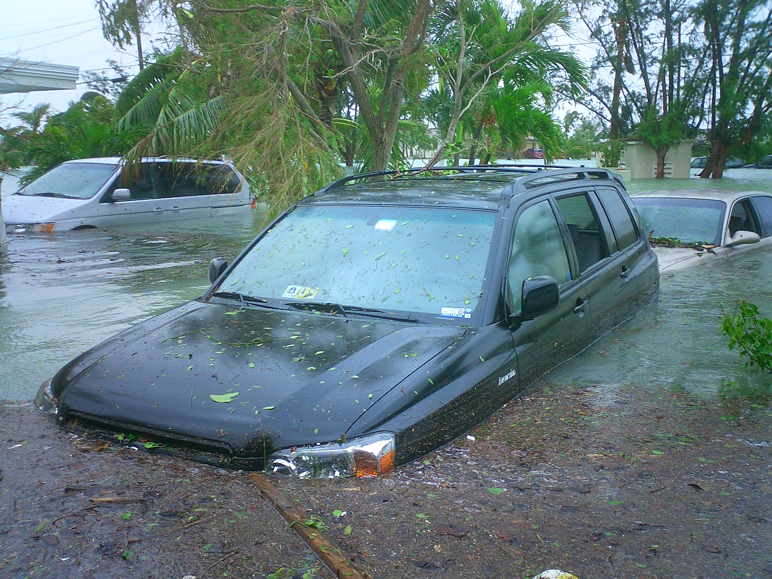
Actually these days it’s more like a flood…

